Slide 1
Pluralistic counselling and psychotherapy
Mick Cooper
Professor of Counselling
University of Strathclyde
mick.cooper@strath.ac.uk
www.pluralistictherapy.com
With thanks to John McLeod, Katherine McArthur and all the clients who contributed data

Slide 2
1. Does one size fit all?

Slide 3
Background
Current moves in NHS towards therapeutic monoculture: ‘one size fits all’
But CBT not right for everyone

Slide 4
Schools and schoolism
History of counselling and psychotherapy characterised by emergence of numerous ‘schools’/‘orientations’
Even integrative/eclectic therapies can be considered ‘schools’, as often advocate one particular combination of methods/ideas
Schools can make many positive contributions to field but ‘schoolism’ – the belief that one’s approach is superior to others – is based on assumption that one particular orientation/method best suited to all clients. Is this true?

Slide 5
1.1 Research evidence

Slide 6
Different clients want different things
King et al, 2000: Do depressed clients in primary care want non-directive counselling or cognitive-behaviour therapy?
40%
60%

Slide 7
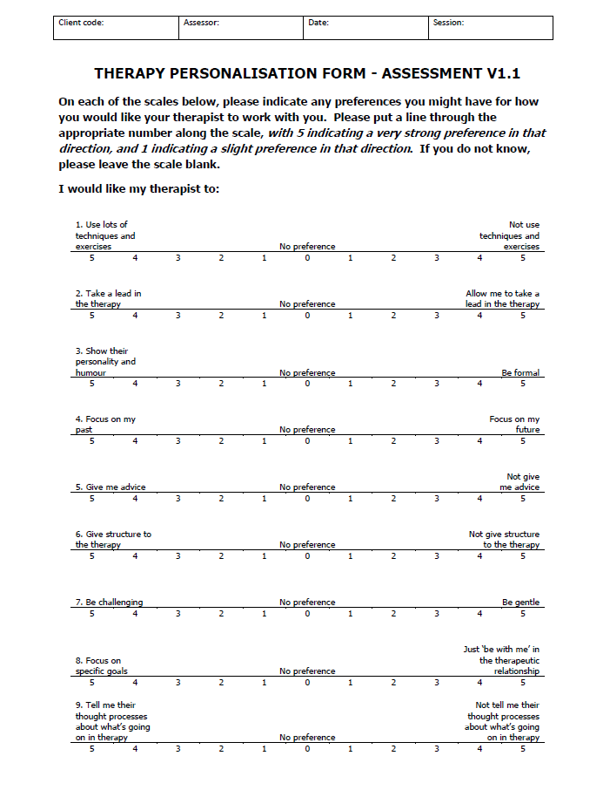
Research evidence...
Findings from the ‘Therapy Personalisation Form’ (Bowens, Johnstone and Cooper) indicate clients want a wide range of things from therapy: both consistent with, and different from, traditional PCE practices

Slide 8
Clients do better in their preferred therapies
Swift and Callahan (2009) (review of 26 studies): clients who received their preferred treatment had 58% chance of showing better outcome improvement (ES = .15), and half as likely to drop out of therapy

Slide 9
Different clients do better in different therapies
Most clients do best when levels of empathy are high, but some clients – highly sensitive, suspicious, poorly motivated – do not
Clients who do best in non-directive therapies cf. CBT:
high levels of resistance
internalizing coping style

Slide 10
Diversity at individual level
Even at level of individual clients, often multiple wants and needs that do not fit neatly into one particular orientation

Slide 11
Ashok: Helpful aspects of therapy
Just talking
Focusing on practical solutions to problems
Looking at each relationship with a man in the past and seeing what attracted me to them
Realising that I am loved
Deciding to look forward and turn a corner
Reading a letter from my father and getting the therapist’s take on it
Just being allowed to go off tangent

Slide 12
Ashok: Helpful aspects of therapy
Just talking (person-centred [PCA])
Focusing on practical solutions to problems (problem-focused)
Looking at each relationship with a man in the past and seeing what attracted me to them (relational)
Realising that I am loved (PCA)
Deciding to look forward and turn a corner (Existential)
Reading a letter from my father and getting the therapist’s take on it (Technique)
Just being allowed to go off tangent (PCA)

Slide 13
1.2 Ethics of diversity

Slide 14
Levinas: An openness to Otherness
An ethical relationship is one in which we are willing to encounter, and prize, the Other in all their Otherness, their:
complexity
heterogeneity
Irreducibility to finite laws, characteristics and assumptions
To meet the face of the other
Notes:
Levinas not commonly associated with humanism: but critical of it because emphasis on man as free, self-creating source not sufficiently human

Slide 15
Most therapies strive to support individuation and autonomy
Aim of therapy is to help individuals become ‘own unique individual self’ (Rogers, 1964): away from conditions of worth and external locus of control
towards ‘increasing self-government, self-regulation, and autonomy, and away from heteronymous control, or control by external forces’ (Rogers, 1951, p. 488)
Ethical commitment to ‘respecting the right of self-determination of others’ (Grant, 2004)

Slide 16
Diverse therapeutic needs because diverse human values
If we accept that different people have different values (e.g., happiness, actualisation, morality, duty, meaning) is ultimate ‘good’, and….
We accept that it is valid/positive for different values to exist (‘value pluralism’), and…
We see the different therapies as being aligned with different values (e.g., happiness/CBT, actualistion/humanistic, meaning/existential, then…
Diversity of therapeutic approaches is essential

Slide 17
2. The pluralistic approach: An introduction

Slide 18
Pluralistic approach
An attempt to transcend schoolism in all its forms (including a ‘pluralistic schoolism’) and re-orientate therapy around clients’ wants and client benefit
Maintaining a critical, self-reflective stance towards our own theoretical assumptions (as well as personal ones)

Slide 19
The pluralistic approach strives to transcend ‘black-and-white’ dichotomies in the psychotherapy and counselling field, so that we can most fully engage with our clients in all their complexity and individuality
From either/or to both/and

Slide 20
Practice A
Practice B
Notes:
Both theory and practice

Slide 21
Theory A
Theory B
Notes:
Both theory and practice

Slide 22
Common factors
Orientation-specific effects

Slide 23
Relationship
Techniques

Slide 24
Single-orientation
Integrative/
eclectic

Slide 25
Therapist-led
Client-led

Slide 26
Individual psychological change
Social/political change

Slide 27
Psychological
Pharmacological

Slide 28
Research-informed
Practice/theory-informed

Slide 29
Intra-therapy change
Real world change

Slide 30
Pluralistic approach: Basic assumption 1 Lots of different things can be helpful to clients
(Even CBT)

Slide 31
Pluralistic approach: Basic assumption 2 If we want to know what is most likely to help clients, we should explore it with them

Slide 32
Pluralistic approach both as perspective and as practice

Slide 33
Pluralistic perspective
The belief that different clients are likely to benefit from different things at different points in time; and that therapists should work closely with clients to help them identify what they want from therapy and how they might get it

Slide 34
Pluralistic practice
A form of therapy, based on a pluralistic perspective, which draws on methods from a multiplicity of therapeutic orientations, and is characterised by dialogue and negotiation over the goals, tasks and methods of therapy

Slide 36
But isn’t pluralism just the same as integrative/
eclectic therapy?

Slide 37
Different forms of integration/ eclecticism
Theoretical integration: select concepts and methods from existing approaches to create a new approach
Assimilative integration: therapist is trained in a core model, then learns about other approaches and gradually integrates them into a unique individual style
Common factors: good outcome depends on achieving non-specific factors such as hope, expression of emotion, etc
Eclecticism: therapist decides what seems to be best for the client
Technical eclecticism (Lazarus): therapist assess clients and decides what is best on the basis of research evidence
Pluralistic approach is a form of integrative/eclectic practice, but:
Is a perspective as well as a practice (so also embraces non-integrative therapies)
Puts particular emphasis on pluralism across ROLES (i.e., client-therapist dialogue), as well as across orientations

Slide 38
Theoretical
Assimilative
Common factors
Pluralistic perspective/stance
Integrative
Pluralistic practice
Low
collaboration
High
collaboration
Person-centred
practice
Standardised
Tailored
Psychodynamic
practice
Eclectic

Slide 39
1900
1950
2000
Pure form
therapies
Integrative
therapies
Eclectic
therapies
Pluralistic
approach

Slide 40
3. Meeting the needs of individual clients

Slide 41
3.1 Being clear about what we offer

Slide 42
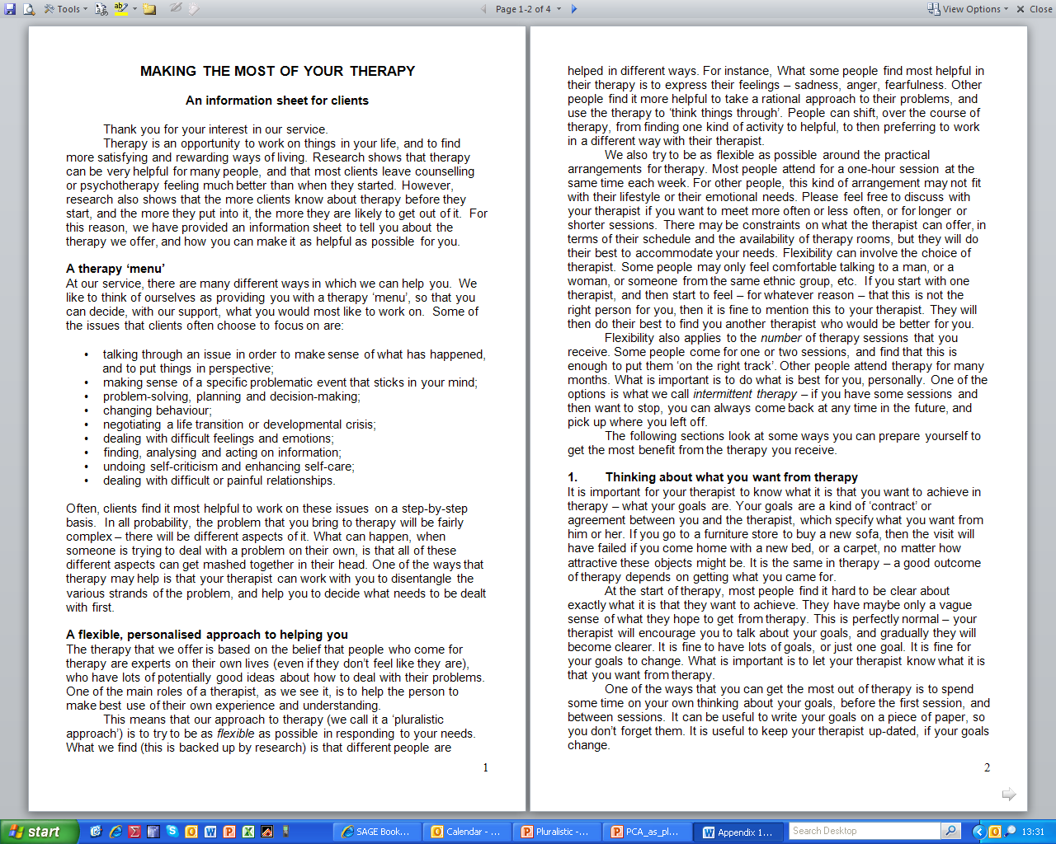

Slide 43
3.2 Beyond intuition

Slide 44
Can we just trust our intuitive sense of what clients need?
A. Research indicates that therapists are generally poor judges of what clients want or experience

Slide 45
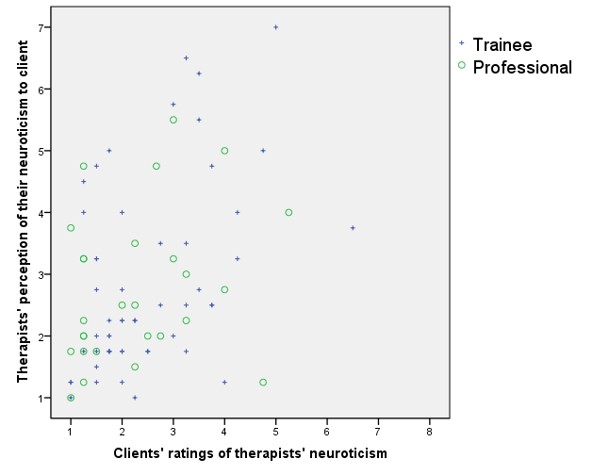
Comparison of clients’ perceptions, and therapists’ metaperceptions, of the therapists’ neuroticism (from Cooper, in press)
Shared variance
Overall: 16%
Trainees: 21%
Professionals: 8%

Slide 46
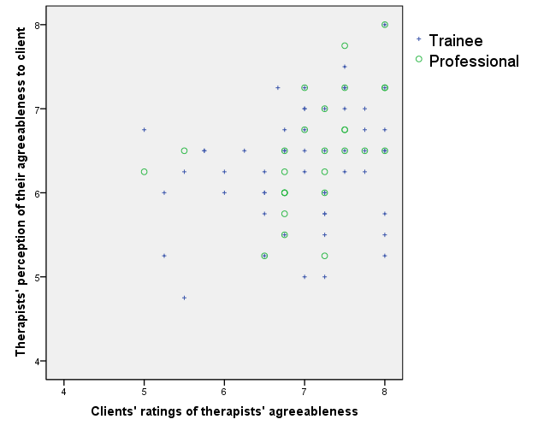
Comparison of clients’ perceptions, and therapists’ metaperceptions, of the therapists’ agreeableness (from Cooper, in press)
Shared variance
Overall: 11%
Trainees: 7%
Professionals: 22%

Slide 47
Client xxx, session 23 post-session feedback forms
Client (‘Greatly helpful’): ‘Tried to allow myself to feel vulnerable…. [The therapist] asked where the sense of shame came from. Not by a dialogue but an invite…. Helps me to realise both the extent to which the fear of being the object or violated by others and the trauma of it plays itself out in a way that involves self-isolation.’
Therapist (‘Neither helpful nor hindering’): ‘Not really connected with much, or much new thing coming out.’

Slide 48
Client yyy, session 5 post-session feedback forms
Therapist (‘moderately helpful’): ‘[It felt helpful for the client to…] think about the strength of his drive for connection and intimacy with others… Develop more awareness of how strong that drive is, and perhaps more able to stand back from it.’
Client (‘Slightly hindering’): ‘When I was talking about my desire for communication/relationships, the therapist said that he imagines how difficult it must be to feel this, and that few people must feel like this. This made me feel kind of “isolated”, i.e., the “only one” feeling like this in the world, and feeling a “problematic” poison. This makes me more sad and scared.’

Slide 49
Client yyy, session 6: Using the feedback
‘Client experienced my empathy and emphasis on the power of his drive for relatedness as isolating: my intention had been to emphasise his uniqueness and personal strengths. Wasn’t discussed at all or raised by client – highlight fact that these things can go totally undetected.’
(post-session notes, session #5)
‘Came back to client at beginning of session and checked out with him where he was at with thing that he was not happy about. Discussed it and felt great to be able to talk about it and clear it up. Invited client to say whether he felt differently or not.’
(post-session notes, session #6)

Slide 50
It’s not just me….
Client and therapist reports of the same episode of therapy often reveal striking differences in perception. For instance:
Client: ‘The counseling was worthwhile. It felt good…. because it was the first time in years I could talk with someone about what’s on my mind.’
Therapist: ‘We were still in the beginning phases of treatment when she pulled out…. I didn’t feel that we were making progress.’ (Maluccio, 1979: 107-8)

Slide 51
It’s not just me….
Therapists’ ratings of the quality of the therapeutic relationship tend to show only moderate agreement with clients’ ratings
In just 30 to 40 per cent of instances do therapists agree with clients on what was most significant in therapy sessions; with therapists tending to over-estimate the importance of technical, as opposed to relational, aspects
Therapists are often poor at predicting the outcomes of therapy, with one study finding that therapists correctly predicted just one out of 42 clients who ultimately deteriorated

Slide 52
And if you still think that doesn’t include you…
Counsellors and psychotherapists tend to overestimate their effectiveness, with one study finding that 90 per cent of therapists put themselves in the top 25 per cent in terms of service delivery

Slide 53
The ‘20% rule’
On average, can assume that the amount of overlap between how we see a process, and how an other person sees it, is about 20%
Our perception
Their perception

Slide 54
Why do we miss so much of what clients experience/want: Deference
Research (Rennie) suggests that clients frequently ‘defer’ to their therapists:
express agreement with therapists when they actually disagree with them
withholding critical or challenging comments
conceal negative reactions and feelings
Overlook/make allowances for therapist’s mistakes
not ask questions about things that are not understood
try to see things from the therapist’s perspective
65% of clients leave at least one thing unsaid during sessions; 46% keep secrets from their therapists, around 50% being of a sexual nature (Hill et al., 1993)
Why do clients defer:
want to be seen as ‘good clients’
out of a fear that therapists will retaliate and the relationship jeopardised
because therapists are perceived as experts in the field
because clients feel powerless
to save the therapist’s ‘face’

Slide 55
And what supervisees don’t say…
Over 97% of trainee psychotherapists had failed to disclose at least one thing to their supervisors (Ladany et al., 1993)
Average of eight nondisclosures per psychotherapist
The two most common categories were:
Negative reactions to supervisor (at least one instance given by 90 per cent of all participants): for example, ‘I thought he was an arrogant asshole who had a big blind spot on how to help me in supervision’
Personal issues (60 per cent): for example, ‘I have not told my supervisor that I am pregnant’
Other categories of non-disclosure included:
Clinical mistakes (44 per cent): for example, ‘I think I sometimes confuse my clients with interventions that are not at the level of the client’s understanding’
Negative reactions to clients (36 per cent): for example, ‘that sometimes I’m bored’
Client‑counsellor attraction issues (25 per cent): for example, ‘found a male client attractive, reminded me of type of guys I used to like’
Supervisor appearance (9 per cent): for example, ‘he wears clothes out of the 70s’

Slide 56
3.3 Listening carefully

Slide 57
Listening carefully to client
Because of deference, clients’ expressions of what they want in therapy may be very subtle/under-stated
Need to attend carefully to/invite further exploration of any hinted cues

Slide 58
3.4 Meta-therapeutic dialogue

Slide 59
Meta-therapeutic dialogue
Inviting clients to explore what they want from therapy (goals), and how they may be most likely to achieve it (methods)

Slide 60
Explore
≠
Doing whatever a client initially asks for, and then sticking to it regardless!
= dialogue
Subtle, complex, on-going process
Draws on expertise of both client and therapist
(and acknowledges limits of both perspectives)
“Best” knowledge comes through co-construction

Slide 61
Collaboration is not about the uncritical acceptance of the client’s viewpoint -- it is about moving beyond its uncritical negation

Slide 62
Co-constructing therapeutic methods I
Following dialogue comes from a first session of therapy between Mick and Saskia (from Cooper and McLeod, 2011, p.111)
Mick asked Saskia what she thought might be helpful to her in the therapy/what she had found helpful or unhelpful with previous therapists
Saskia replied that she had found it unhelpful when there is ‘just a man sitting behind you’ not giving you any feedback -- she said that she wanted lots of input and guidance
Mick was fairly happy to work in this way, but also sensed that Saskia had a relatively ‘externalised locus of evaluation’ and had some concerns about reinforcing this

Slide 63
Co-constructing therapeutic methods II
Mick: So it sounds like feedback will be useful?
Saskia: Yeah, Yeah.
Mick: OK.
Saskia: Yes, definitely, because….no matter who we are in the world, wherever we are in life, there is always going to be something that we’ve missed, either because we don’t want to see it, or because we just didn’t see it. Even if someone is 90% ‘actualised’…they’re not going to see everything. [So] you [can] turn around and say: ‘You could have said this, you could have done that.’ And they’re: ‘Oh, really, thanks Mick, I never-- I never saw that.’
Mick: I guess the important thing for me, in giving feedback, is that you can say ‘That’s not right’ [Saskia: Sure.] And you can say, ‘No, that doesn’t fit,’ or ‘That’s not helpful’ [Saskia: Sure, sure.]. I mean, one of the ways that I like to work is-- is very much with feedback…and that needs you to say to me, ‘No, don’t like that…’ ‘That’s good…’

Slide 64
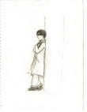
Marcel meta-communicating around formulation
Social anxiety
Previous therapy exploring abuse
Did he need to do it again?

Slide 65
Session 3
Client talking about flashbacks:
‘I just can’t be bothered with it any more’
Do I need to go back into abuse to sort it out? ‘Is it just going to be there and I have to accept it?’
Therapist (15:09):
‘I guess part of the question is how much is it related to the problems that you are experiencing at the moment, and that is what we don’t really know (Client: ‘I don’t really know… It doesn’t really logically link with the problems’).

Slide 66
Session 3
Explored other possibilities:
Related to experiences of being humiliated in school?
Related to fear of others judging her, being disappointed?
Client: ‘… I think I’ve always let the anxiety put me off doing it [public speaking], so I could actually figure out if… If I’ve done it a few times, that wasn’t as bad…’

Slide 67
Session 3
Therapist: ‘We’re kind of talking about what causes that difficulty, and I guess there are a number of possibilities.
One is that… it is about stuff that happened in your past that has made it really difficult for you and has really inhibited you and made you really anxious
Another one is that it’s something that you’re just not good at it and you may as well give up and it’s not really that much about your past
I guess there is another one, that you’re talking about there, that is about a pattern that you have got into, or a cycle, that isn’t so much… that is not so much caused by things in your past, so much as you’ve started avoiding doing that kind of talking, and because you’ve avoided doing it you’ve built it up as something that is more and more frightening, and actually if you started doing it a bit more you would, as you are saying, that ‘It’s not actually that bad… it’s bearable’
Client: ‘I’m just thinking about those: it could be a pattern of behaviour I’ve just got into…

Slide 68
Helpful Aspects of Therapy
‘At last week’s session talking about patterns of behaviour got me thinking about this and how stuck I have been in a pattern of behaviour’
(Session 4: Helpful aspects of Therapy form – rated 8/9 ‘greatly helpful’)

Slide 69
Opportunities for meta-therapeutic dialogue I
Before therapy begins
Initial contact
Therapy information/letter/website
Initial session/assessment
What client wants (goals)
What client would/has/might find helpful (task, methods)

Slide 70
Opportunities for meta-therapeutic dialogue II
Start of sessions
Focus, goals, agenda
End of sessions
What was helpful/unhelpful
For next week…
As homework: to set agenda for next meeting
Within sessions
Stuck points/ruptures
After new methods introduced
After specific goals achieved
Following client feedback/questioning
Using measures

Slide 71
Opportunities for meta-therapeutic communication III
Scheduled/regular review sessions
Progress
Goals/methods
End of therapy
Review
Strategies for ongoing development

Slide 72
Wants: Possible prompts
‘Do you have a sense of what you want from our work together?’
‘What do you hope to get out of therapy?’
‘So I wonder what’s brought you here?’
‘What kind of things would you like to change in your life?’
‘What do you see as the goals for this therapeutic work?’
‘Where would you like to be by the end of therapy?’
‘If you were to say just one word about what you wanted from this therapy, what would it be?’
‘What would have to be minimally different in your life for you to consider our work together a success?’ (Duncan, et al., 2004: 69)
‘What will be the first sign for you that you have taken a solid step on the road to improvement even though you might not yet be out of the woods?’ (Duncan, et al., 2004: 69)

Slide 73
Methods: Possible prompts
If you’ve had therapy in the past, what sort of things have been helpful to you?
What kind of things help you get what you want?
What would you want from me as a therapist?
How do you think I can best help you get what you want?

Slide 74
Being pluralistic about meta-therapeutic communication
Collaboration, meta-communication, outcome measures etc may not be helpful for all clients
“As a client, I felt like she would ask me how the session had been for me at the end of every session as a kind of mini-review and I just felt totally, like, put on the spot, and still trying to process whatever we had been talking about. So it kind of took me out of what I had been thinking about and I lost touch with the process, rather than become absorbed in it. And then I do the sort of people pleaser thing of trying to be like “Yeah, yeah, it was really good, really helpful”, and really want to answer her question as I do not want to say anything was unhelpful as that feels really uncomfortable. I would never say anything unhelpful.
(from client experience research by Keri Andrews, counselling psychologist)

Slide 75
3.5 Using measures to facilitate meta-therapeutic dialogue

Slide 76
Feedback measures
Because clients often find it difficult to voice concerns/issues (‘deference’), measures can provide a ‘third space’ to express feelings
Although can feel mechanistic, research suggests that clients generally ok with them/like them
Recent research (Lambert, Hubble) suggests some forms of outcome monitoring may substantially enhance outcomes

Slide 77
Therapy Personalisation Form
20 scale tool that invites clients to say how they would like therapy to be
Can be used at assessment (TPF-A)
And in ongoing therapeutic work/at review

Slide 78
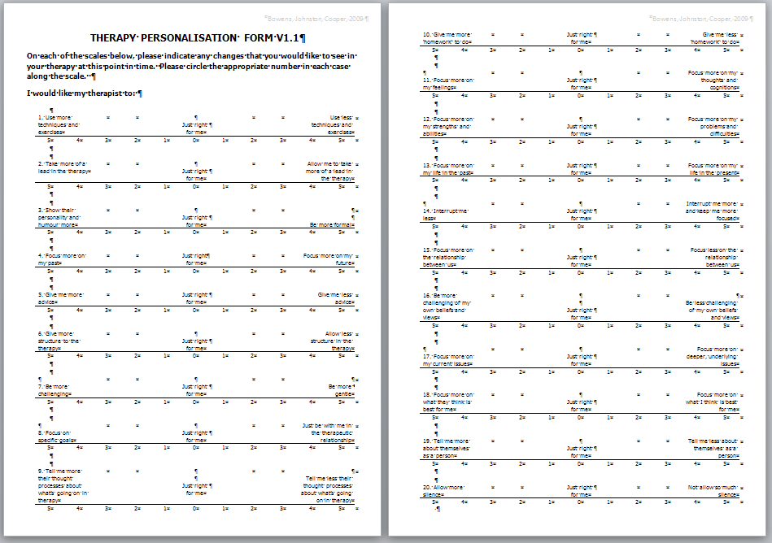

Slide 79
Therapists’ experiences of using the TPF and TPF-A (Bowens, 2011)
POSITIVE IMPACT For Therapist A way of finding out what clients want Permission to alter/tailor practice A source of learning & reflection Encouraging/reassuring for therapists Facilitating supervision For Client Empowering clients & increasing autonomy/responsibility/choice Giving clients permission to assert/express things For Relationship Moving the therapy forward Deepening the relationship Facilitates collaboration NEGATIVE IMPACT For Therapist Potentially increase self-criticism Danger of moulding self too much For Client Too complex for some clients For Relationship Potentially bureaucratic/impersonal | n participants 9 9 8 7 3 8 7 7 4 3 4 3 6 4

Slide 80
Client experience of TPF
Mixed: TPF probably easier than TPF-A, as client has more of a sense of what they are wanting once therapy starts
Some positive:
‘I like the form with the rating scale that asks you to assess how the therapy is going [TPF] – it gives a chance to bring certain things up and discuss them and this also makes me feel more comfortable.’

Slide 81
Debbie….
Second episode of therapy
TPF-A indicated that she wanted:
To be more focused
To be more challenged
To focus more on our relationship
Led to therapist taking a different, more challenging, active, present
Feedback on end of session forms indicated that Debbie continued to want this challenge
Work took on very different flavour

Slide 82
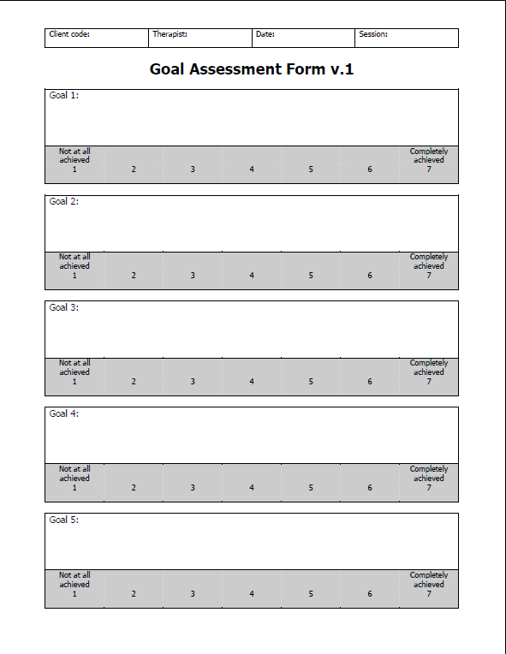
Goal Assessment Form
Personalised
Invites clients to focus on what they want
Discussed and agreed in assessment session
Rated every subsequent week
Can be added to /modified as therapy progresses

Slide 83
Work in progress
Cooper, M., & McLeod, J. (2007). A pluralistic framework for counselling and psychotherapy: Implications for research. Counselling and Psychotherapy Research, 7(3), 135-143.
Cooper, M., and McLeod, J. (2011). Pluralistic counselling and psychotherapy. London: Sage.

Slide 84
Thank you

